Slide 1


Sambe Consulting BIOps Presentation 08 May 2024
Data Led: Intelligent Insights
www.sambeconsuting.com

Slide 2



Agenda
1
Use Case Scenario
4
2
Use Case Scenario(Cont.)
5
Use Case Diagram
3
7
4
Sequence of Demo
9
5
Sequence of Demo (Cont.)
11
5
SSIS & Elasticsearch Demo
12

Slide 3


Understanding BIOps
By
Data Led: Intelligent Insights

Slide 4


Understanding BIOps
Dev
Ops
BI
Ops
What is BI Ops ?
Is the DevOps of BI.

Slide 5
Use Case Scenario
By
Data Led: Intelligent Insights

Slide 6

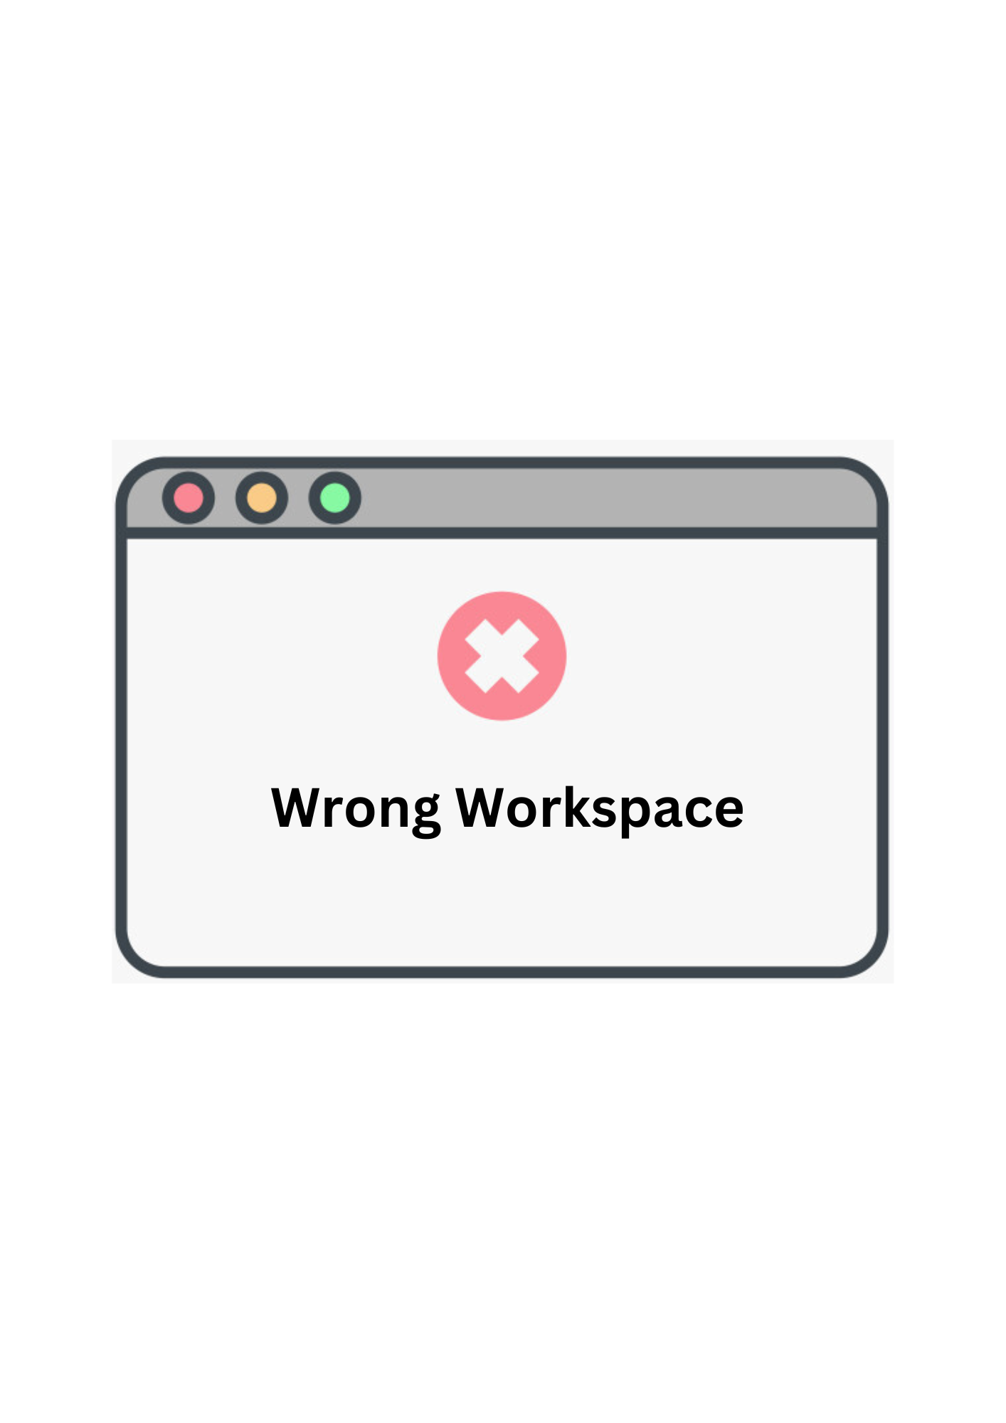



Use Case Scenario
Objective is to highlight the benefits of automating Power BI report deployments to Power BI Services and utilizing GitHub for version control over manual processes.
Benefits of Automated Deployment with Version Control:
Minimised Human Error
Reduced Workload
Up-to-Date Reports
Enhanced Traceability and Collaboration

Slide 7
BIOps Environment Workflow
By
Data Led: Intelligent Insights

Slide 8
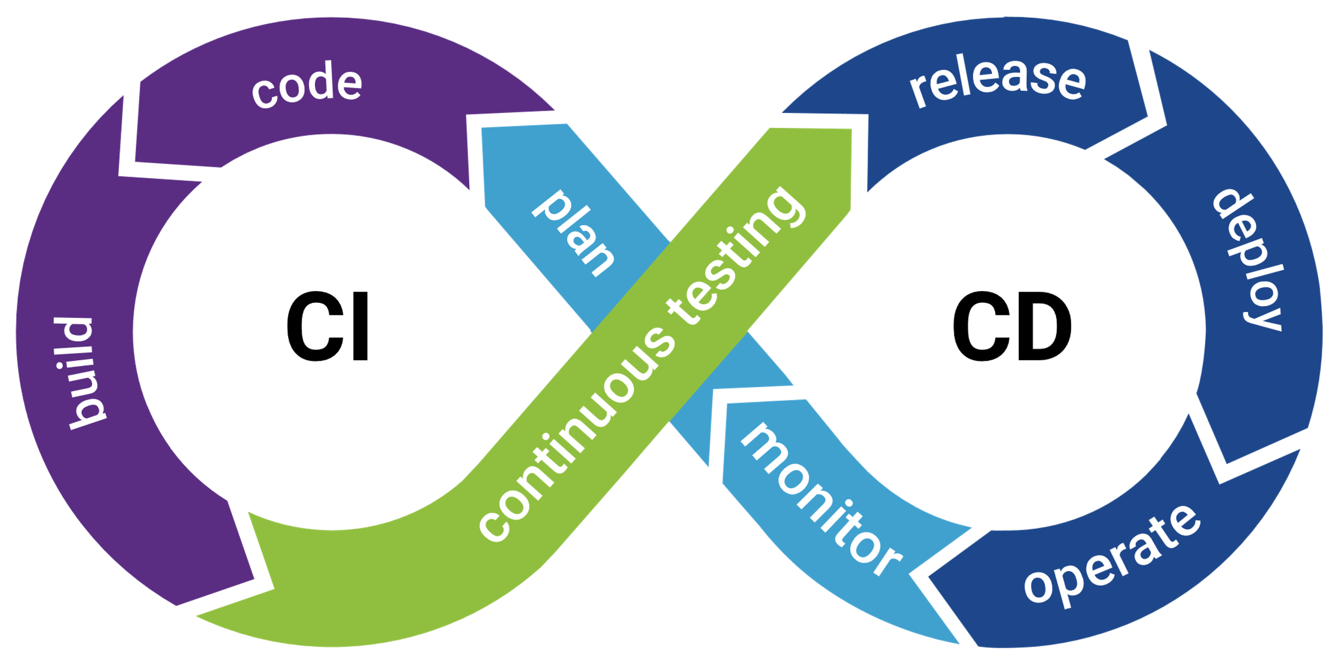
BIOps Environment Workflow

Slide 9


BIOps Environment Workflow
CI Pipeline
Main
Finalised Version
Looks Good Let's Deploy!
Dev
Pre-Prod Version

Slide 10







BIOps Environment Workflow (cont.)
CD Pipeline
Client
Main
Power BI Service

Slide 11
Sequence of Demo
By
Data Led: Intelligent Insights

Slide 12
Sequence of Demo

Slide 13







Sequence of Demo

Slide 14
BIOps Demo
By Chosen Ones Graduate Team
Data Led: Intelligent Insights

Slide 15




Thank You
Chosen Ones – Sambe Consulting
2024 Graduates
-
info@sambeconsulting.co.za
www.sambe.co.za
1 Maxwell Drive, Woodmead, Sandton, 2191
Data Led: Intelligent Insights
www.sambeconsuting.com

